Slide 1

Database Systems
Department of Computer Science
Chungbuk National University
Prof. Jong Yun LEE

Slide 2
Table of Contents
PART 1 Introduction to databases
Chapter 1 Databases and Database Users
Chapter 2 Database System Concepts and Architecture
PART 2 Conceptual Data Modeling and Database Design
Chapter 3 Data Modeling Using the Entity-Relationship (ER) Model
Chapter 4 The Enhanced Entity-Relationship (EER) Model

Slide 3
Table of Contents
PART 3 Conceptual Data Modeling and Database Design
Chapter 5 The Relational Data Model and Relational Database Constraints
Chapter 6 Basic SQL
Chapter 7 More SQL: Complex Queries, Triggers, Views
Chapter 8 The Relational Algebra and Relational Calculus
Chapter 9 Relational Database Design by ER- and EER-to-Relational Mapping
PART 6 Design Theory and Normalization
Chapter 14 Basics of Functional Dependencies and Normalization for Relational Databases
Chapter 15 Further Dependencies

Slide 4
Table of Contents
PART 7 File Structures, Hashing, Indexing, and Physical Database Design
Chapter 16 Disk Storage, File Structures, Hashing
Chapter 17 Indexing Structures for Files and Physical DD
PART 8 Query Processing and Optimization
Chapter 18 Strategies for Query Processing
Chapter 19 Query Optimization
PART 9 Transaction Processing, Concurrency Control, and Recovery
Chapter 20 Introduction to TP Concepts and Theory
Chapter 21 Concurrency Control Techniques
Chapter 22 Database Recovery Techniques

Slide 5
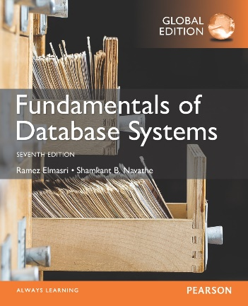
CHAPTER 1: Databases and Database Users

Slide 6
Introduction

Slide 7
OUTLINE
Types of Databases and Database Applications
Basic Definitions
Typical DBMS Functionality
Example of a Database (UNIVERSITY)
Main Characteristics of the Database Approach
Types of Database Users
Advantages of Using the Database Approach
Historical Development of Database Technology
Extending Database Capabilities
When Not to Use Databases

Slide 8
Types of Databases and Database Applications
Traditional Applications:
Numeric and Textual Databases
More Recent Applications:
Multimedia Databases
Geographic Information Systems (GIS)
Biological and Genome Databases
Data Warehouses
Mobile databases
Real-time and Active Databases
First part of book focuses on traditional applications
A number of recent applications are described later in the book (for example, Chapters 24,25,26,27,28,29)

Slide 9
Recent Developments (1)
Social Networks started capturing a lot of information about people and about communications among people-posts, tweets, photos, videos in systems such as:
Facebook
Twitter
Linked-In
All of the above constitutes data
Search Engines- Google, Bing, Yahoo : collect their own repository of web pages for searching purposes

Slide 10
Recent Developments (2)
New technologies are emerging from the so-called non-database software vendors to manage vast amounts of data generated on the web:
Big Data storage systems involving large clusters of distributed computers (Chapter 25)
NoSQL (Not Only SQL) systems (Chapter 24)
A large amount of data now resides on the “cloud” which means it is in huge data centers using thousands of machines.

Slide 11
Basic Definitions
Database:
A collection of related data.
A collection of data that requires to operate and manage an organization
Data:
Known facts that can be recorded and have an implicit meaning.
Miniworld:
Some part of the real world about which data is stored in a database. For example, student grades and transcripts at a university.
Database Management System (DBMS):
A software package/ system to facilitate the definition and manipulation (insert, update, delete, retrieve) of a computerized database.
Database System:
The DBMS software together with the data itself. Sometimes, the applications are also included.
DBS = Databases + DBMS + Application Programs + Users + …

Slide 12

Impact of Databases and Database Technology
Businesses:
Banking, Insurance, Retail, Transportation, Healthcare, Manufacturing
Service Industries:
Financial, Real-estate, Legal, Electronic Commerce, Small businesses
Education :
Resources for content and Delivery
More recently:
Social Networks, Environmental and Scientific Applications, Medicine and Genetics
Personalized Applications:
based on smart mobile devices

Slide 13
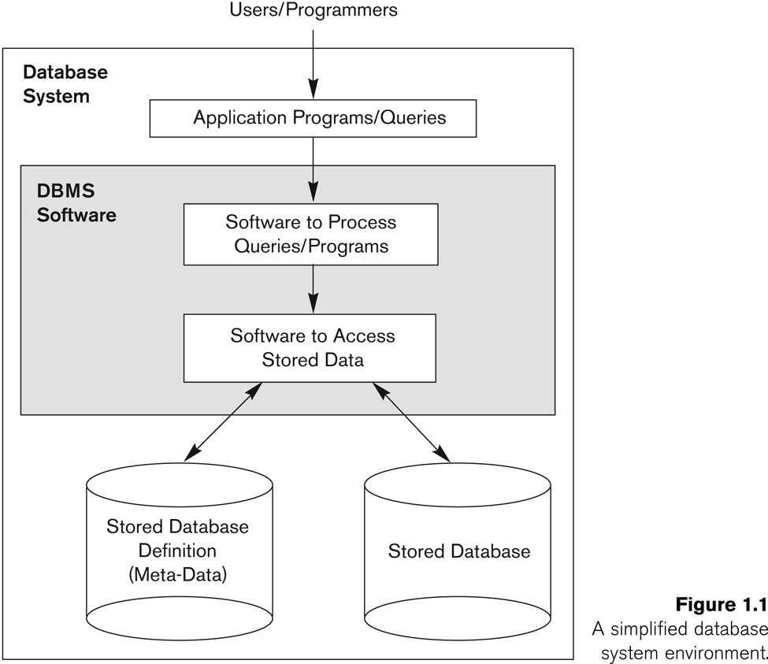
Simplified Database System Environment

Slide 14
Typical DBMS Functionality
Define a particular database in terms of its data types, structures, and constraints
Construct or Load the initial database contents on a secondary storage medium
Manipulating the database:
Retrieval: Querying, generating reports
Modification: Insertions, deletions and updates to its content
Accessing the database through Web applications
Processing and Sharing by a set of concurrent users and application programs – yet, keeping all data valid and consistent

Slide 15
An Example

Slide 16
Example of a Database (with a Conceptual Data Model)
Mini-world for the example:
Part of a UNIVERSITY environment.
Some mini-world entities:
STUDENTs
COURSEs
SECTIONs (of COURSEs)
(academic) DEPARTMENTs
INSTRUCTORs

Slide 17
Example of a Database (with a Conceptual Data Model)
Some mini-world relationships:
SECTIONs are of specific COURSEs
STUDENTs take SECTIONs
COURSEs have prerequisite COURSEs
INSTRUCTORs teach SECTIONs
COURSEs are offered by DEPARTMENTs
STUDENTs major in DEPARTMENTs
Note: The above entities and relationships are typically expressed in a conceptual data model, such as the ENTITY-RELATIONSHIP data model (see Chapters 3, 4)

Slide 18

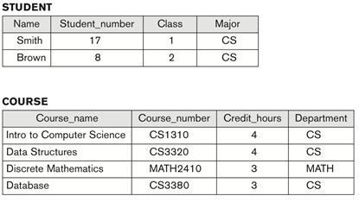
Example of a simple database
Figure 1.2 A database that stores student and course information.

Slide 19
Main Characteristics of the Database Approach

Slide 20
Main Characteristics of the Database Approach
Self-describing nature of a database system:
A DBMS catalog stores the description of a particular database (e.g. data structures, types, and constraints)
The description is called meta-data*.
This allows the DBMS software to work with different database applications.

Slide 21
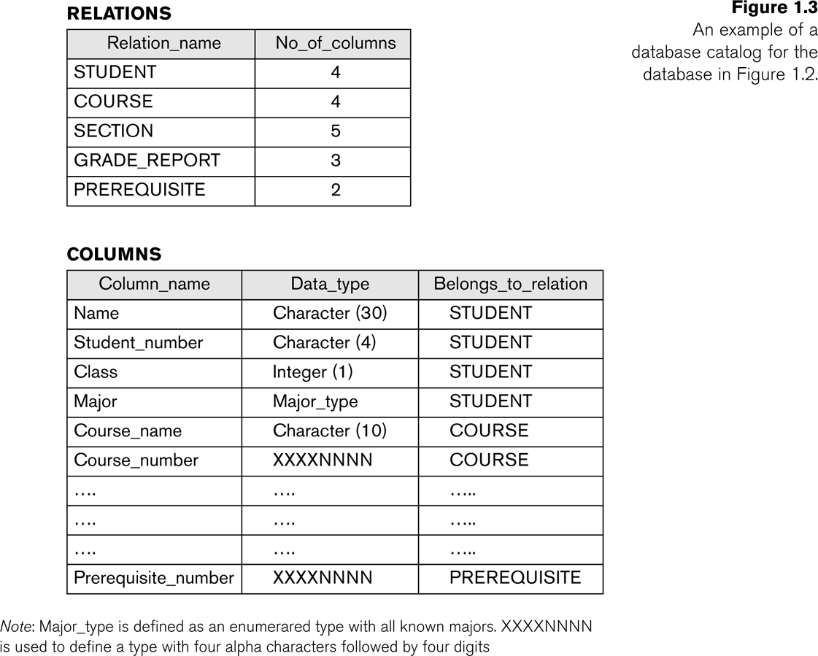
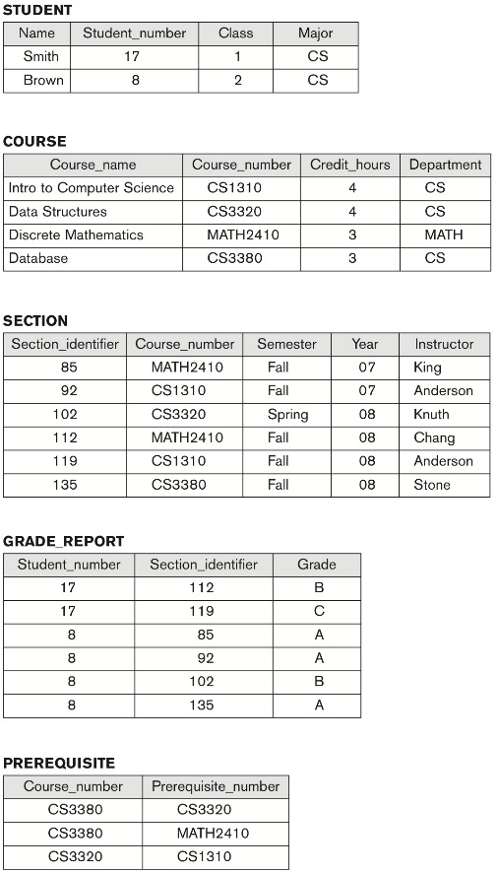
Example of a simplified database catalog
Tables(catalog) are describing tables
Figure 1.2

Slide 22
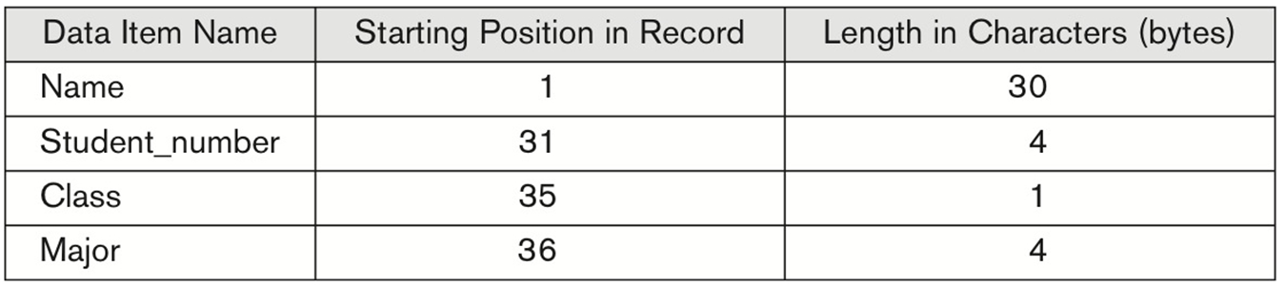
Main Characteristics of the Database Approach
Insulation between programs and data:
Called program-data independence.
Allows changing data structures and storage organization without having to change the DBMS access programs.
Internal storage format for a STUDENT record, based on the database catalog in Figure 1.3.

Slide 23
Main Characteristics of the Database Approach (continued)
Data Abstraction:
A data model is used to hide storage details and present the users with a conceptual view of the database.
Programs refer to the data model constructs rather than data storage details

Slide 24
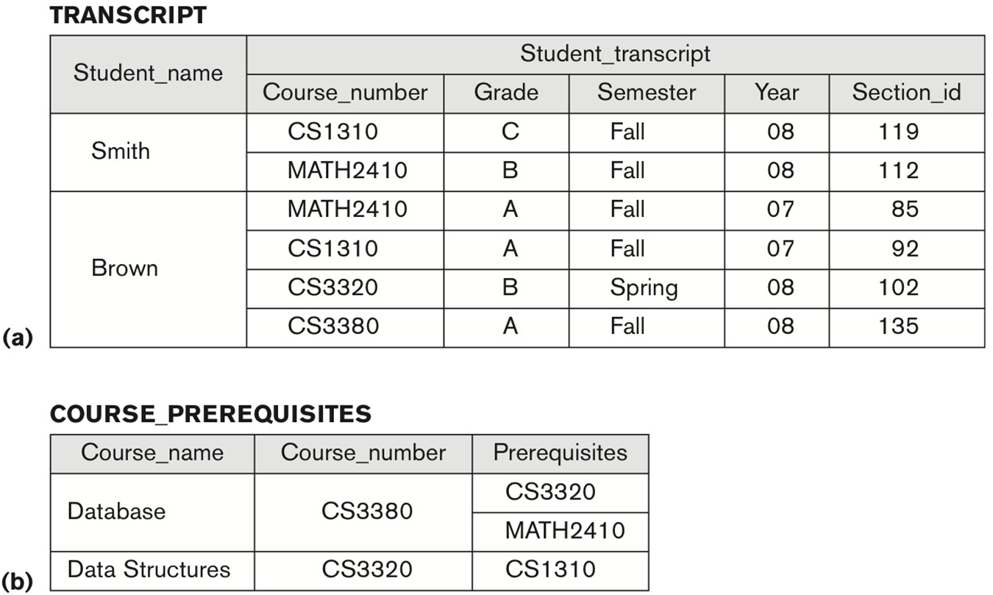
Main Characteristics of the Database Approach (continued)
Support of multiple views of the data:
Each user may see a different view of the database, which describes only the data of interest to that user.
Two views derived from the database in Figure 1.2.
The TRANSCRIPT view.
The COURSE_PREREQUISITES view.

Slide 25
Main Characteristics of the Database Approach (continued)
Sharing of data and multi-user transaction processing:
Allowing a set of concurrent users to retrieve from and to update the database.
Concurrency control within the DBMS guarantees that each transaction is correctly executed or aborted
Recovery subsystem ensures each completed transaction has its effect permanently recorded in the database
OLTP (Online Transaction Processing) is a major part of database applications. This allows hundreds of concurrent transactions to execute per second.

Slide 26
Actors on the Scene

Slide 27
Database Users
Users may be divided into
Those who actually use and control the database content, and those who design, develop and maintain database applications (called “Actors on the Scene”), and
Those who design and develop the DBMS software and related tools, and the computer systems operators (called “Workers Behind the Scene”).
Users
Peoples who are related with database systems

Slide 28
Database Users
Database Administrators:
Responsible for authorizing access to the database, for coordinating and monitoring its use, acquiring software and hardware resources, controlling its use and monitoring efficiency of operations.
Database Designers:
Responsible to define the content, the structure, the constraints, and functions or transactions against the database. They must communicate with the end-users and understand their needs.

Slide 29
Database End Users
End-users:
use the data for queries, reports and some of them update the database content.
End-users can be categorized into:
Casual: access database occasionally when needed
Naïve or Parametric: they make up a large section of the end-user population.
They use previously well-defined functions in the form of “canned transactions” against the database.
Users of Mobile Apps mostly fall in this category
Bank-tellers or reservation clerks are parametric users who do this activity for an entire shift of operations.
Social Media Users post and read information from websites

Slide 30
Database End Users (continued)
Sophisticated:
These include business analysts, scientists, engineers, others thoroughly familiar with the system capabilities.
Many use tools in the form of software packages that work closely with the stored database.
Stand-alone:
Mostly maintain personal databases using ready-to-use packaged applications.
An example is the user of a tax program that creates its own internal database.
Another example is a user that maintains a database of personal photos and videos.

Slide 31
Database Users
System Analysts and Application Developers
This category currently accounts for a very large proportion of the IT work force.
System Analysts:
They understand the user requirements of naïve and sophisticated users and design applications including canned transactions to meet those requirements.
Application Programmers:
Implement the specifications developed by analysts and test and debug them before deployment.
Business Analysts:
There is an increasing need for such people who can analyze vast amounts of business data and real-time data (“Big Data”) for better decision making related to planning, advertising, marketing etc.

Slide 32
Workers behind the Scene

Slide 33
Workers behind the Scene
System Designers and Implementers:
Design and implement DBMS packages in the form of modules and interfaces and test and debug them. The DBMS must interface with applications, language compilers, operating system components, etc.
Tool Developers:
Design and implement software systems called tools for modeling and designing databases, performance monitoring, prototyping, test data generation, user interface creation, simulation etc. that facilitate building of applications and allow using database effectively.
Operators and Maintenance Personnel:
They manage the actual running and maintenance of the database system hardware and software environment.

Slide 34
Advantages of using the DBMS Approach

Slide 35
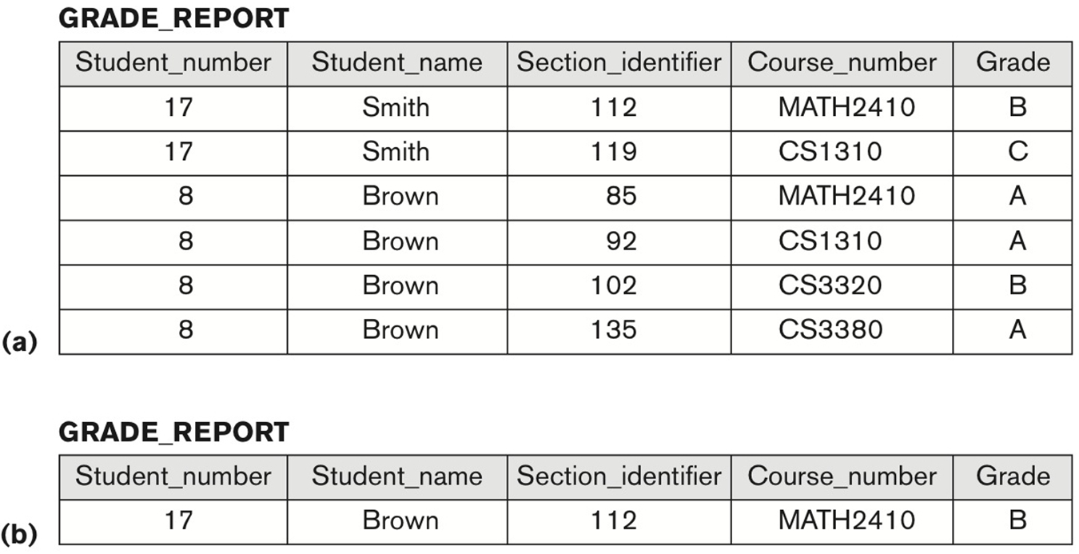
Advantages of Using the Database Approach
Controlling (reducing) redundancy in data storage and in development and maintenance efforts.
Sharing of data among multiple users.
Figure 1.6 Redundant storage of Student_name and Course_name in GRADE_REPORT. (a) Consistent data. (b) Inconsistent record.

Slide 36
Advantages of Using the Database Approach
Sharing data from multiple users
Restricting unauthorized access to data. Only the DBA staff uses privileged commands and facilities.
Providing persistent storage for program Objects
E.g., Object-oriented DBMSs make program objects persistent– see Chapter 12.
Providing Storage Structures (e.g. indexes) for efficient Query Processing – see Chapter 17.

Slide 37
Advantages of Using the Database Approach (continued)
Providing optimization of queries for efficient processing.
Providing backup and recovery services.
Providing multiple interfaces to different classes of users.
Representing complex relationships among data.
Enforcing integrity constraints on the database.
Drawing inferences and actions from the stored data using deductive and active rules and triggers.

Slide 38
Additional Implications of Using the Database Approach
Potential for enforcing standards:
This is very crucial for the success of database applications in large organizations. Standards refer to data item names, display formats, screens, report structures, meta-data (description of data), Web page layouts, etc.
Reduced application development time:
Incremental time to add each new application is reduced.

Slide 39
Additional Implications of Using the Database Approach (continued)
Flexibility to change data structures:
Database structure may evolve as new requirements are defined.
Availability of current information:
Extremely important for on-line transaction systems such as shopping, airline, hotel, car reservations.
Economies of scale:
Wasteful overlap of resources and personnel can be avoided by consolidating data and applications across departments.

Slide 40
A Brief History of Database Applications

Slide 41
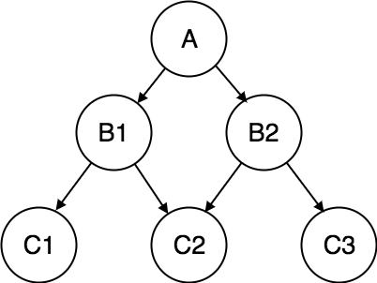
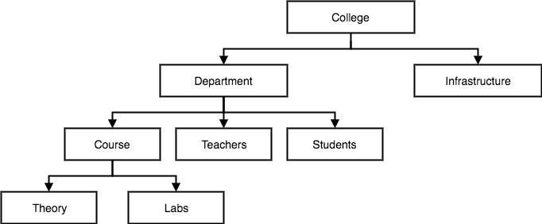

Historical Development of Database Technology
tightly coupled
Early Database Applications:
The Hierarchical and Network Models were introduced in mid 1960s and dominated during the seventies.
A bulk of the worldwide database processing still occurs using these models, particularly, the hierarchical model using IBM’s IMS system.
conceptual design ↔ physical design
Charles William Bachman III (Born on December 11, 1924 – July 13, 2017) was an American computer scientist.
Hierarchical Model
Network Model
a top-down structure
supports one-to-one and
one-to-many relationships
supports one-to-one
one-to-many
and many-to-many relationships
problem was the inability to support ad hoc queries

Slide 42

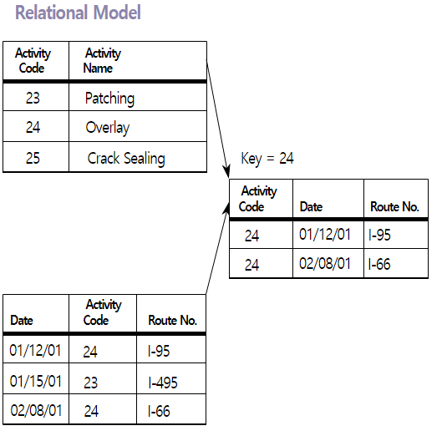
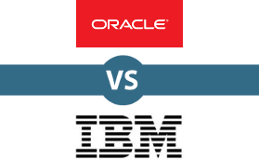
Historical Development of Database Technology
independence
Relational Model based Systems:
Relational model was originally introduced in 1970, was heavily researched and experimented within IBM Research and several universities.
Relational DBMS Products emerged in the early 1980s.
conceptual design ↔ physical design
Edgar Frank "Ted" Codd (19 August 1923 – 18 April 2003) was an English computer scientist who, while working for IBM, invented the relational model for database management, the theoretical basis for relational databases and relational database management systems.

Slide 43
Historical Development of Database Technology (continued)
Object-oriented and emerging applications:
Object-Oriented Database Management Systems (OODBMSs) were introduced in late 1980s and early 1990s to cater to the need of complex data processing in CAD and other applications.
Their use has not taken off much.
Many relational DBMSs have incorporated object database concepts, leading to a new category called object-relational DBMSs (ORDBMSs)
Extended relational systems add further capabilities (e.g. for multimedia data, text, XML, and other data types)

Slide 44
Historical Development of Database Technology (continued)
Data on the Web and E-commerce Applications:
Web contains data in HTML (Hypertext markup language) with links among pages.
This has given rise to a new set of applications and E-commerce is using new standards like XML (eXtended Markup Language). (see Ch. 13).
Script programming languages such as PHP and JavaScript allow generation of dynamic Web pages that are partially generated from a database (see Ch. 11).
Also allow database updates through Web pages

Slide 45
Extending Database Capabilities (1)
New functionality is being added to DBMSs in the following areas:
Scientific Applications – Physics, Chemistry, Biology - Genetics
Earth and Atmospheric Sciences and Astronomy
XML (eXtensible Markup Language)
Image Storage and Management
Audio and Video Data Management
Data Warehousing and Data Mining – a very major area for future development using new technologies (see Chapters 28-29)
Spatial Data Management and Location Based Services
Time Series and Historical Data Management
The above gives rise to new research and development in incorporating new data types, complex data structures, new operations and storage and indexing schemes in database systems.

Slide 46
Extending Database Capabilities (2)
Background since the advent of the 21st Century:
First decade of the 21st century has seen tremendous growth in user generated data and automatically collected data from applications and search engines.
Social Media platforms such as Facebook and Twitter are generating millions of transactions a day and businesses are interested to tap into this data to “understand” the users
Cloud Storage and Backup is making unlimited amount of storage available to users and applications

Slide 47
Extending Database Capabilities (3)
Emergence of Big Data Technologies and NOSQL databases
New data storage, management and analysis technology was necessary to deal with the onslaught of data in petabytes a day (10**15 bytes or 1000 terabytes) in some applications – this started being commonly called as “Big Data”.
Hadoop (which originated from Yahoo) and MapReduce Programming approach to distributed data processing (which originated from Google) as well as the Google file system have given rise to Big Data technologies (Chapter 25). Further enhancements are taking place in the form of Spark based technology.
NOSQL (Not Only SQL- where SQL is the de facto standard language for relational DBMSs) systems have been designed for rapid search and retrieval from documents, processing of huge graphs occurring on social networks, and other forms of unstructured data with flexible models of transaction processing (Chapter 24).

Slide 48
When Not to Use a DBMS

Slide 49
When not to use a DBMS
Main inhibitors (costs) of using a DBMS:
High initial investment and possible need for additional hardware.
Overhead for providing generality, security, concurrency control, recovery, and integrity functions.
When a DBMS may be unnecessary:
If the database and applications are simple, well defined, and not expected to change.
If access to data by multiple users is not required.
When a DBMS may be infeasible:
In embedded systems where a general purpose DBMS may not fit in available storage

Slide 50
When not to use a DBMS
When no DBMS may suffice:
If there are stringent real-time requirements that may not be met because of DBMS overhead (e.g., telephone switching systems)
If the database system is not able to handle the complexity of data because of modeling limitations (e.g., in complex genome and protein databases)
If the database users need special operations not supported by the DBMS (e.g., GIS and location based services).

Slide 51
Chapter Summary
Types of Databases and Database Applications
Basic Definitions
Typical DBMS Functionality
Example of a Database (UNIVERSITY)
Main Characteristics of the Database Approach
Types of Database Users
Advantages of Using the Database Approach
Historical Development of Database Technology
Extending Database Capabilities
When Not to Use Databases

